Slide 1
HND Networking: Multi User Operating Systems (DH3A 34) Week 3
Lecturer – Dawn Wilson

Slide 2
Virtual box & Linux
Oracle virtualisation application
www.virtualbox.org
virtualises a standard PC and its associated hardware
Allows you to run an alternative OS i.e. Linux, inside the virtual machine
Debian Linux 8
Running virtual machine
C:\Debian\Debian
Login – root
Password – password
All data is stored locally, therefore use the same PC each week
To log out of virtual machine
File->Close

Slide 3
Installing virtual box and Debian
Copy the Debian folder from the C drive and this will give you the virtual machine with the Linux install
Alternatively you can install the latest version of virtual box from virtualbox.org and then create a new virtual machine with the latest Debian iso downloaded from debian.org
See instructions – Virtual Machine Instructions.doc

Slide 4
Adding a user account - Debian
the root user gives you a lot of power and flexibility however it is also dangerous and can be destructive. It is almost always a better idea to add an additional, unprivileged user to do common tasks.
Debian command adduser to create a user account:
adduser <username>
This asks for a password and personal details to create the account.
It edits /etc/passwd, /etc/shadow, /etc/group and /etc/gshadow files for the newly created User account.
Creates and populates a home directory for the new user i.e. /home/<username>
Sets permissions and ownerships to home directory.

Slide 5
Interacting with the OS
Most users do not interact directly with the OS, they use applications or provided utilities
Interacting directly with the OS is normally only attempted by technical users and system administrators.
Technical users such as software engineers are required to install and configure clients software on Linux servers therefore they need to be able to access the file system
System administrators have to install, configure and maintain the server. This involves maintaining the network environment, maintaining the health of the servers (security), keeping the OS up to date, installing/maintaining any application software, addressing issues raised by users e.g. performance.

Slide 6
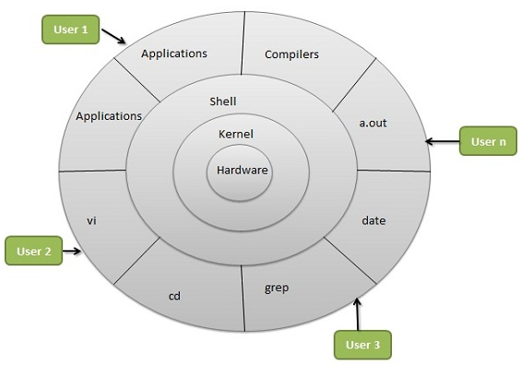
Linux Shell
At the heart of the OS is a core series of machine instructions known as the Kernel, which has control over everything that occurs in the system
Kernel is a technical program, not user-friendly , designed to communicate with electronic components
So how do we communicate with the Kernel?
A Linux “shell” is a facility that allows the user to communicate directly with the Kernel in a human-readable form
Shell translates English style command line instructions so they can be processed by the Kernel
Default Linux shell program is called the Bourne Again Shell (BASH)

Slide 7
Linux Command Format
On most Linux systems a program called bash (which stands for Bourne Again SHell, an enhanced version of the original Unix shell program, sh) acts as the shell program
shell understands a large number of commands, each of which are entered at the prompt
You should see a shell prompt that contains your user name and the name of the machine followed by a dollar sign. Something like this:
[me@linuxbox me]$
Commands can have a number of options that may be specified to modify their behaviour, each option is prefixed by a hyphen
Some commands accept arguments that provide data to be used by the command
Typical syntax of a shell command:
command –option argument
If the last character of your shell prompt is # rather than $, you are operating as the superuser (logged in as root user)

Slide 8
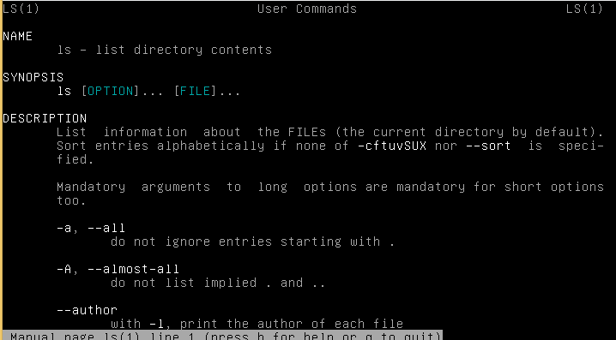
Linux Commands
When describing commands I use the < > notation to indicate that you must replace this with a value, and the description of the value is given within the angled brackets
man <command> - allows users to access the system's on-line manual pages. The manual pages give you full information on the command you search for i.e. description, options, arguments
e.g. man ls
Navigating man pages
Up/Down- Up & Down Keys Page Up/Down - PgUp/PgDn Keys Search - '/foo' Search Next - '/' or N key Summary of Commands (help) - h Quit - q Down 1 Screen - Spacebar or D Up 1 Screen - B Down 1 line - Enter

Slide 9
Linux Commands
COMMAND | DESCRIPTION
man | on-line manual pages
ls | list all files/sub-directories
date | current date and time
who | list of users logged on to system
cal | produces a calendar for any given date

Slide 10
ACTIVITY
S:\hdcomp\Dawn\HND-MUOS\Exercises\Activity1-LinuxCommands.docx

Slide 11
What is a File System?
A file system is a collection of files in some sort of hierarchy, which provides an underlying structure for the operating system to store programs and data
In windows we group related files into folders. In Linux we refer to folders as directories.
A directory can be empty or contain files

Slide 12
Linux File System
The Linux file system is organised hierarchically, with the structure referred to as a tree
The top of the tree is referred to as the root and is denoted by the forward slash character (/)
directories (folders) can be thought of as branches
files as leaves.
sub-directories can hold any mixture of directories and/or files (i.e. branches can sprout leaves or more branches).

Slide 13
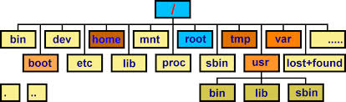
Linux File System

Slide 14
Linux File System Standard Directories
/bin – small executable programs (binaries)
/sbin – binaries only used by root superuser and during boot or recovery
/lib – binary library files used by executables in /bin, /sbin
/dev – special device files to allow programs access to device drivers
/boot – contains kernel
/etc – system configuration files
/proc – a view of internal kernel data
/mnt – general purpose mount point
/usr – contains sub-directories storing programs that can be run by any user
/var – variable data files storing info about ongoing system status
/home – contains a sub-dir for each user account to store personal files
/tmp – temporary files created by running programs
/root – home dir for the root account superuser
/opt – area where large static application s/w packages can be installed
The directories above are the standard structure of a typical Linux installation – they are not always present at install time.
This structure and the described purpose is generally adhered to by developers to ensure consistency when locating files.

Slide 15
Linux file system Vs Windows file system
Linux | Windows
Case-sensitive | Not case-sensitive
Directories and files have ownership permissions | Directories and files are generally universally accessible
Developed as a MUOS | Evolved from DOS as a SUOS
Only “root” super user can change system settings | Users have free reign to wreak havoc
Partitions created using Ext3 filesystem | FAT, FAT32, NTFS filesystems
Path names contain forward slash / | Path names contain backwards slash \
No drive letters - everything contained within a single unified hierarchical system beginning with root directory (/) | Uses drive letters. Typically C: for hard disk drive, D: for CD/DVD drive, E: for external drive

Slide 16
Linux File System Paths
The location of a file within the hierarchical tree structure is defined by a path
i.e. the path you need to follow through the tree to find the file
There are 2 types of path:
Absolute path – the path to the file starting at the root of the tree
Relative path – the path to the file starting at your current location within the tree

Slide 17
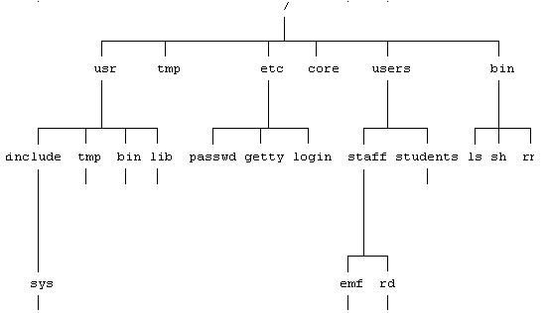
File System - Paths
Absolute path - To uniquely identify a file, that file has to be described in terms of the path from the root of the tree right down through each level to the file itself
e.g. to access the passwd file - /etc/passwd
A forward slash at the beginning of the path means start at the root, any subsequent forward slash characters means move to the next level
it is possible to have two directories with the same name (i.e. bin) on the tree. However, there cannot be two identically named directories on the same level of the same branch.

Slide 18
File System - Paths
Relative path – specifies the location of a file/directory relative to the current location
How do we find out our current location? Use the command:
pwd (stands for print working directory)
The current location is known as the “working” directory
e.g. if the current working directory was users, the relative pathname of the “rd” directory would be staff/rd

Slide 19
File System - Paths
What if the current working directory was rd and we wanted to provide a relative path to the lib directory?
We cannot jump across the branches, we must always stay connected to the tree and follow a path
we have to go back up the tree, across and then down
How do we go back up the tree? …

Slide 20
File System Paths – special directory notations
. | Current directory
.. | Parent directory
~ | Home directory
We can use these special abbreviations denoted in the table to move within our file path
To refer to the current directory we use a single dot (.)
To refer to the parent directory i.e. go up one level, we use two dots (..)
To jump to the users home directory we use a tilde (~)
So if the current working directory is rd and we want to provide the relative path to lib then the pathname would be:
../../usr/lib
(move up 2 levels then along to usr and down a level to lib)

Slide 21
Linux Files
Data Files
normally created by the system's users and will simply be text files containing a sequence of ASCII characters.
Executable files
When users enter Linux commands at the keyboard, what they are in effect doing is loading and then running executable files.
In addition to these, users can create their own executable files by writing and then compiling their programs in languages such as C
The resulting executable files can also be loaded and run by simply entering their name at the Linux command line prompt.
Device files (special files/devices)
Linux provides a standard interface between the Operating System and hardware peripherals which act like normal files.
This means that data is read from a device by reading a device file, and data is written to a peripheral by writing to a file.
This is not a disk file, but a special file, which refers to the Input/Output channel for that device.
/dev

Slide 22
Linux File Names
Must not exceed 255 chars
Must not contain a / character
Must not contain any spaces
Case sensitive
Can include
Upper case letters (A-Z)
Lower case letters (a-z)
Numbers (0-9)
Underscores (_)
Hyphens (-)
Dots (.)
Extensions (textfile.txt)
Other characters found on keyboard i.e. *, & but not recommended as could have special meaning

Slide 23
File Management Commands
The following section will cover the most commonly used file management commands

Slide 24
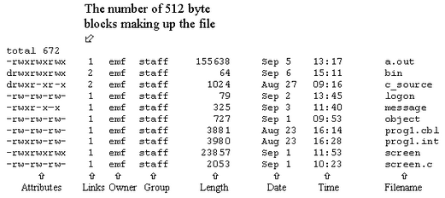
List contents of a directory - ls command
used to list the files which are present in a directory
The -l option will produce a 'long listing‘
The –a option will show any hidden files

Slide 25
Update/create a file -touch command
Updates the access time and modification time to the current time and date
If a file does not exist, touch creates it with a file size of 0
touch can be used on one or more files:
touch file1
touch file1 file2 file3

Slide 26
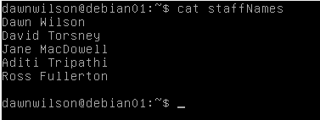
Display/create file contents - cat command
displays the contents of a text file (only use on text file)
cat <file_name>
cat /users/staff/.profile
Can also be used to create a file:
cat > testfile
Allows you to type in some text then , [Ctrl][Z] will save what you have typed to the file i.e. testfile
Issuing the cat command without a file will allow you to collect data from the command line until you enter [Ctrl][Z] to indicate you are finished.
The > symbol is the “redirection” symbol, indicating output from this command is redirected to a file called testfile.

Slide 27
Display file contents - more command
also used to display the contents of (text) files
useful because if ‘cat’ used to display the contents of a long file the text will quickly scroll off the top of the screen
more screen.cbl
more /etc/conf/gen/S800
When more is used, the display will pause after each screen, and then you can press the following keys:
[Space] - To move to the next screen,
[Enter] - To display the next line, and
[Ctrl] [C] - To stop displaying the file.

Slide 28
Display file contents - pg command
also used to display the contents of text files by showing the file one screen at a time
more flexible than more, because the user can move backwards and forwards through the file
Common options used with the pg command are:
-c
This will clear the screen and place the cursor in the 'home' position (i.e. the top left corner of the screen) before displaying each page of text.
-p
Allows the user to select a prompt. This option must be followed by a string, for example:
pg -p# prog1.c

Slide 29
Send file to printer - lp command
The lp command is used to send files to the system's default printer, for example
lp prog1.c
would send the file called prog1.c in the current working directory to the printer.

Slide 30
Copy file - cp command
used to copy files
cp <source> <destination>
If the data to be copied is not located in the current working directory, a path must be given
The destination can either be a filename or a directory name
filename - this will be used to name the copy of the source file
directory - the file or files to be copied will be placed in that directory, with the actual names of the files remaining the same.
If a file already exists with the same name as the one being copied, it will be overwritten without any warning being given to the user
cp prog1.c prog1.bak
cp /users/staff/emf/prog1.c prog1.c
cp /users/staff/emf/prog1.c /users/staff/jan

Slide 31
Rename/move file - mv command
used to rename and/or move files
mv old_name new_name
mv prog1.cbl prog1.bak
if there is already a file in existence with the same name as the one being used to rename the file, then that file will be overwritten
If a directory is given as the destination the file will be moved into that directory. For example:
mv prog1.cbl cbl_files
mv command can also be used to rename or move directories

Slide 32
Delete file - rm command
used to delete files, and cannot (without specifying options) be used to remove directories
rm file_name
rm prog1.cbl
rm /users/staff/emf/prog1.cbl

Slide 33
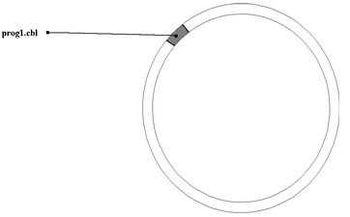
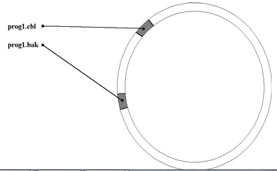
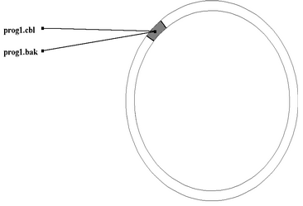
Create a link to file/directory - ln command
Creates a link to a specified target with optional link name
ln prog1.cbl prog1.bak
cp
ln

Slide 34
ACTIVITY
S:\hccomp\Dawn\MUOS\Exercises\Activity2-LinuxCommands2.docx

Slide 35
Wildcards
Wildcards allow the user to create patterns that can be used to match patterns in filename (and directory names)
This makes searching, copying, deleting much easier when working with groups of files/directories
There are three wildcard characters available which can simplify access to groups of files
* ? []

Slide 36
Wildcard *
The asterisk matches any number of characters that occur at a particular position in a pattern
simplest form, * can be used to access all the files in a directory, for example:
cp * backup
ls -l pr*
would generate a long listing of all files (in the current working directory) whose names begin with the letters pr
ls-l *c
would generate a long listing of all files whose names ends with the letter c
ls -l *.*
will produce a long listing for those files with a full stop in their filename
ls -l *.c
will access the files whose name ends in .c

Slide 37
Wildcard ?
used to substitute for one character
ls prog?
would list those files whose names begin with the letters prog followed by one other character
rm prog?.c
would delete all the files whose name starts with prog, followed by one character, followed by .c
wildcard characters can be mixed freely, for example
ls -l prog*.?

Slide 38
Wildcard []
represent any of the characters enclosed in the brackets
file *[xyz]*
all objects in the current directory that have an x, y and/or z in them
ls *.[xyz]*
list all files that had an extension that begins with x, y or z
file [a-f]*
When a hyphen is used between two characters in the square brackets wildcard, it indicates a range inclusive of those two characters.
all of the objects in the current directory that begin with any letter from a through f

Slide 39
Creating a directory - mkdir command
used to create a new directory
mkdir directory_name
mkdir c_progs
command will fail (and an error message displayed) if the directory already exists, or, there is a file already present with the same name as that chosen for the new directory
mkdir wordprocessor/documents
make a sub-directory called documents within the wordprocessor directory. Would fail if wordprocessor sub-directory was not already present
mkdir -p wordprocessor/documents
other directories given as part of the path will be created if they are not already present

Slide 40
Removing a directory - rmdir command
used to remove directories
rmdir directory_name
The rmdir command will fail if
The directory specified is not empty
The directory specified does not exist
The name given for the directory is actually a file
The user does not have permission to remove the directory.
rmdir /users/staff/emf/pascal
rmdir t*
-i option causes the removal of one or more directories to be carried out interactively (i.e., the user will be prompted as to whether or not a directory is to be deleted)

Slide 41
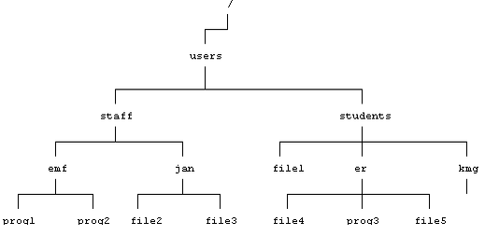

Slide 42
Changing directory - cd command
used to change the current working directory, allowing users to move to various positions on the directory tree
cd directory_name
cd /
move to the root directory
cd users/staff/emf
move from the root level to the home directory of the user emf
cd
immediately return the user to their home directory
pwd
print working directory

Slide 43
Parent, current and home directories
. | Current directory
.. | Parent directory
~ | Home directory
These abbreviations can be used in place of pathnames when commands are entered
cd ..
Move up one level on the directory tree (i.e. change directory to the parent directory)
cd ../staff
Move up one level and then down into the staff sub-directory.
cd ~/wordprocessor
Move into the wordprocessor directory, which is contained within the home directory
cp ../* .
Copy all the files one level up on the directory tree down to the current working directory.

Slide 44
File Permissions
The left hand column gives an indication of the permissions for the various entries, with the first character in this column indicating whether the entry is a file (denoted by a -), or a directory (using a d)
the first nine characters in the first column show the permissions which have been set for the various file and/or directories. These nine characters are split up into three groups of three characters

Slide 45
File Permissions
First three characters = permissions for owner (user)
Middle three characters = permissions for other members of the group to which the user belongs
Last three characters = permissions for everyone else on the system (referred to as other)
In each group of three characters, an r, w and x are used to denote read, write and execute permissions respectively. A dash (-) in any position indicates that the permission usually placed at that point has been removed
check_call has access rights of -rwxr-x—x
This gives the owner of the file read, write and execute permission, members of the group read and execute rights, and execute only to other users on the system

Slide 46
Changing file permissions - chmod command
used to make alterations to file and directory permissions
chmod <table 1 choice> <table 2 choice> <table 3 choice> <filename>
The file message has the permissions --wx-wx-wx
Issuing the command chmod o-w message
would remove write permission for 'other', meaning that only the owner of the file and members of his or her group would then have write access to the file. The new permissions are --wx-wx—x
The file test has the permissions --wx--x—x
Issuing the command chmod u+r test
would give read permission to the owner of the file (i.e., user). After the command had been issued, the permissions would be -rwx--x--x
u | user
g | group
o | other
+ | add
- | remove
= | set
r | read
w | write
x | execute
table 1
table 2
table 3

Slide 47
Changing file permissions - chmod command
Alternatively:
place a three digit number between the chmod command and the name of the file or directory whose permissions are to be altered
first digit indicates the permissions being granted to the owner, the second digit for the group access rights and the final digit for the permissions required for other
Each type of permission (read, write and execute) is allocated a numeric value
each of the three digits is the total of the permissions being granted to either owner, group or other
chmod 777 file2
grant read, write and execute rights to owner, group and other, 7 being the total of the read, write and execute permissions being granted (4+2+1)
4 | read
2 | write
1 | execute

Slide 48
ACTIVITY
S:\hccomp\Dawn\MUOS\Exercises\Activity3-LinuxCommands3.docx

